Slide 1
Colour Images

Slide 2
Modifications to our structure for colour
240
240
63
Now we need three
separate matrices,
one for each colour.
Each matrix holds
values which represent
the corresponding
colour in the image
240
63
63
Our matrix is now
Of size
640 x 480 x 3

Slide 3
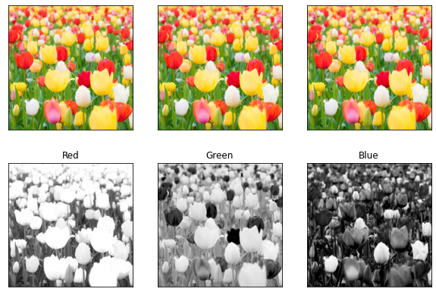
Tulips in RGB
Notes:
http://eeweb.poly.edu/~yao/EL5123/lecture1_intro.pdf

Slide 4
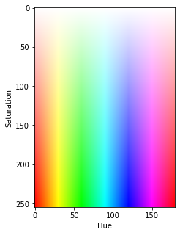

Slide 5
